Slide 1
MATT CREATIVES SALES REPORT FOR YEAR 2013 AND 2014
Group 13

Slide 2
Executive summary
Office supply is an integral part of any business environment and with adversement in technology its likely some of them face out.this effect was seen in our product ceetainly some of this product wil still be relevant in the many years to come
We did a revenue of 121.22M with a profit of 13.83M with our sum of unit sold at 1.13M. The product that did pretty well was bairo while notepad and stapler reduced our profit with a negative profit.
For the fourth quarter of 2014 our revenue and profit is greater than that of 2013 although we have bairo as our product doing well in both quarters. IN 2014 we had more sales by state, ogun state and by our market segment government, the product that did well in 2014 was bairo.penxil gave us the least profit in 2014Q4 while A4 paper gave us the least profit in 2013Q4
Due to bairo been our top profit by product it is encouraged we maintain that spot and not just for it alone but to see that other of our product do well in the next coming financial year

Slide 3
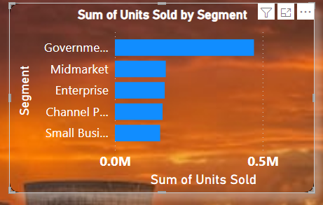
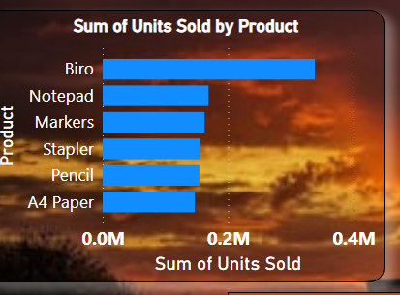
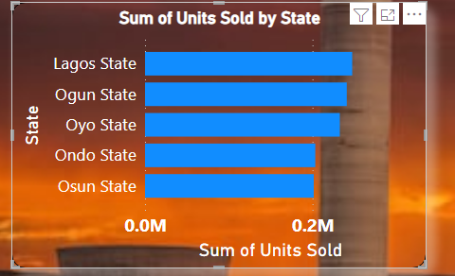
2. A review of segment, product and state by count of sale
From the above visuals by sum of units sold by segment we can see that the government take the lead, by product bairo leads
And by state Lagos has the highest

Slide 4
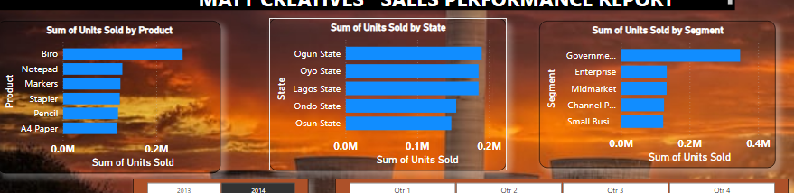
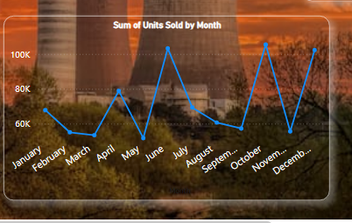
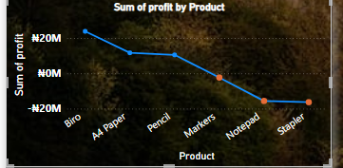
Report on all products sales in the year 2014
For count of sales in year 2014
we did a total sales od 863.13k In which the month of OCTOBER with total count of 185.k the highest
IN 2014 we had more sales in
ogun state and by our market segment government is the highest and the product that did well in 2014 was bairo
The product with the highest profit was
Bairo but there was a decline in our profit with markers,notepad and stapler

Slide 5
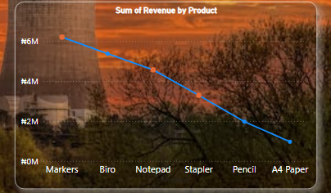
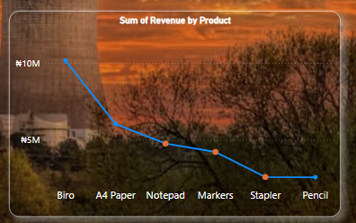
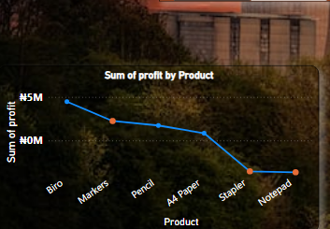
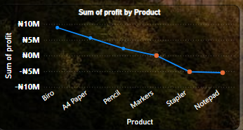
Sales report comparison between 2013Q4 and 2014Q4
Year 2013, Q4
Year 2014,Q4
We had more revenue and profit in
Q1 of 2014 than that of 2013 even though we had a sharp drop of our
Sales in November of 2014
Bairo gave the highest profit while
In both quarters while pencil gave us the least profit in 2014Q4 and A4 paper gave us the least profit in 2013Q

Slide 6
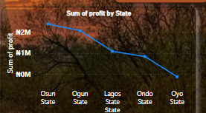
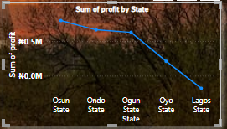
Comparison between 2013Q4 and 2014Q2
insights
2013,Q4
2014,Q4
In the 4th quarters of 2013 we saw osun state taking the lead by profit both in Q4 of 2013 and 2014 respectively
We also saw that oyo was the least in 2013 while lagos is the least in 2014 in addition by count of sales lagos still has the highest between the years

Slide 7
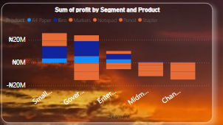
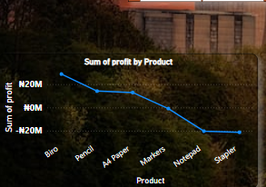
Key product by performance
From the three visials we saw that by count of sales bito did well ,by profit bairo yake the lead and last;y by use which the segment bairo did well
So bairo is our key product performance

Slide 8
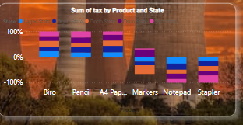
Product with highest tax by segment and state
Over all we saw that the bairo has the highest by tax by product this is due it highest profit
For the state the produxt with the highest tax is bairo which is oyo state
For segment(government) the product with the highest tax is bairo

Slide 9
Recommendation
It’s obvious that bairo is doing well across board and the segment that made use of our bairo the most is the government, which means there is a market there what if we push more advert we can do better than this.
I strongly advice we discontinued the sales and production of stapler. I advice we strongly that we discontinued the sales and production of stapler and notepad because it reduce our total profft.

Slide 10
Conclusion
Since the purpose of any enterprise is to maximise profit we must look at those segment I have highlighted and see that we channel all our energy to it. we should not be afraid to tell our customers that we are not supplying them with our notepad and stapler.
Thank you .

